Slide 1
Basket Analysis
[Names]

Slide 2
Introduction
Project Idea:
Purchases at a grocery store are often ingredients to a larger meal, paired together, or just frequently bought together by a similar demographic. It would save so much time and improve overall shopping satisfaction if the items that are commonly purchased together were near each other.

Slide 3
Problem Statement
Finding what products are frequently purchased together in order to optimize store product location.

Slide 4
Goals
Higher Average Order Value
When customers see the perfect companion item at exactly the right moment (online or in-store), they’re more likely to add it—lifting basket size and making every order more profitable.

Slide 5
The Data
Instacart is a same-day grocery delivery and pickup platform that partners with hundreds of retailers nationwide.
Shoppers place orders via the Instacart app or website, and local “Instacart Shoppers” pick, pack, and deliver items often within one hour.
With real-time inventory updates and substitution options, it offers a seamless, personalized online grocery experience.

Slide 6
InstaCart Online Grocery Basket Analysis Dataset
Downloaded from: Kaggle
Originally scraped from InstaCart
Size: 713mb, ~3 Cr+ Rows
Six Sheets: aisles.csv, departments.csv, order_products__prior.csv, order_products__train.csv, orders.csv, and products.csv
Notable Column Data: aisle, department, product, order, and hour of order
Aisles- Data provided here includes information about aisles, such as aisle names and aisle IDs, and how products were organized within them.
Department- This dataset provides information on the department such as department names and department ID
Order_Products_prior/Order_Products_train- In this dataset, all order details for any prior orders are included, including information on orders, products, and reordered items. Order_Products_train is the same as order_products_prior and it is trained dataset.
Orders- This dataset has information about customer orders like order ID, order number, weekday of the order, an hour of the order, user ID, and days since the prior order.
Products- This dataset gives information on the products which were sold to customer such as product name, product ID, aisle and departments.
The Metadata

Slide 7
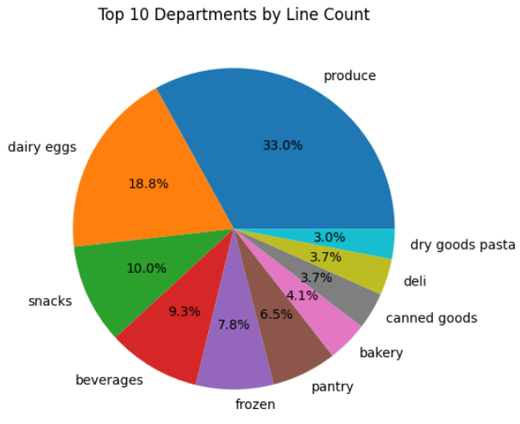
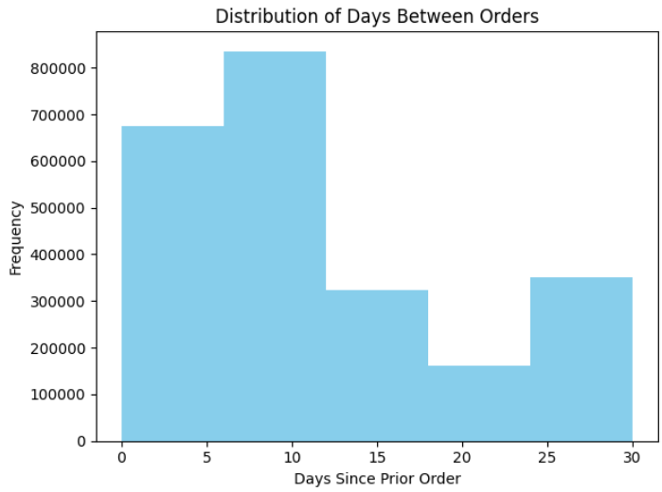
Exploratory Data Analysis
Produce alone accounts for roughly one-third of all items.
Dairy & eggs and snacks are the next two, at ~19 % and ~10 %.
The remaining seven departments each contribute less than 10 %—so even small layout tweaks there can unlock outsized lifts.
The largest bucket of reorders falls in the 7–10 day range (the tallest bars).
A secondary peak around 25–30 days suggests a monthly “stock-up” cycle.
You can target two distinct campaigns: a weekly nudge for staples and a monthly reminder for bulk items.

Slide 9
Data Preparation

Slide 10
Distributed Computing and Development Environments
[Go into how we used each]
AWS Cluster
Spark
Docker

Slide 11
FP-Growth Model

Slide 12
Frequently Bought Together

Slide 13
Cross Department Analysis

Slide 14
Recommendations

